Slide 1
WorksOS Volume Calculations
Trimble Civil Construction
March 2022

Slide 2
WorksOS Volumes Calculations
Objects used in performing volume calculations:
Machine ‘As Built’ Surfaces
Surfaces using machine data, usually last past of prior date to last pass of current date
Surveyed Surfaces
Surveyed Surfaces are not required for Volume Calculations, as you can always calculate volume from one machine surface to another machine surface by date filtering.
If Surveyed Surfaces are not imported into the project, we cannot calculate volumes where machines have not completed more than one pass.
A Surveyed Surface can now be imported with a date prior to any machine data and it will be the ‘Start Date’ for any ‘Project Extents’ date filters.
Composite Surfaces
Composite Surfaces are a combination of machine as built surfaces and the surveyed surface.
Designs
Designs are required for Work Remaining Volume Calculations. Without a Design, the system does not know what surface you are building to.
Multiple designs (Subgrade, Finish Grade, Utilities, etc.) can be imported and used to filter Work Remaining.
You can create offset designs in WorksOS.

Slide 3
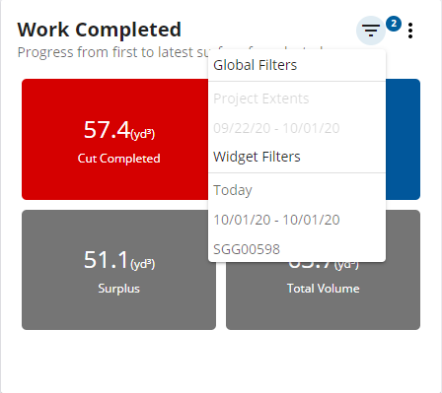
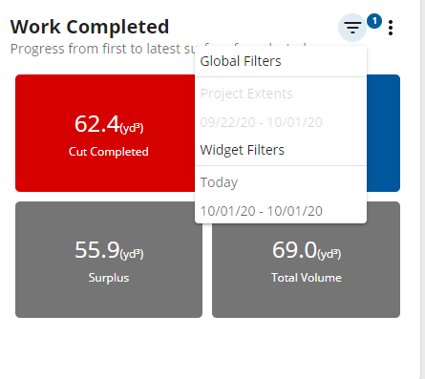
WorksOS Volume Filters
Filters that include Surveyed Surfaces:
Date/Time - provided you select a Date/Time that includes the Survey Date of a Surveyed Surface.
Custom Area
All other Filters exclude Surveyed Surfaces when applied, i.e., they snap to Machine data only and automatically 'filter out' Surveyed Surfaces as they all look for machine data values only.
Machine Filter Applied
Date Filter Only Applied
Machine Last Pass
Machine Last Pass
Previous Machine Passes
Previous Machine Passes
Surveyed Surface
Surveyed Surface
Volume we Calculate
Volume we Calculate

Slide 4
WorksOS Work Completed
Work Completed calculates the volume in place between a past machine surface and the latest machine surface.
When a Surveyed Surface is included it will also the volume in place between the surveyed surface and the latest machine surface.
Work Completed
Work Completed (with a Surveyed Surface)
Machine Last Pass
Machine Last Pass
Volume Completed
Volume Completed
Volume Completed
Previous Machine Pass
Previous Machine Pass
Surveyed Surface
Work Completed (from Project Extents)
Machine Last Pass
Volume Completed
First Machine Pass
Original Ground Surveyed Surface

Slide 5
WorksOS Work Remaining
Work Remaining calculates the volume remaining between machine surfaces and design surfaces
When a Surveyed Surface is included it will also calculate the volume between the surveyed surface and the design boundary
Work Remaining
Work Remaining (with a Surveyed Surface)
Design Surface
Design Surface
Volume Remaining
Volume Remaining
Volume Remaining
Machine Last Pass
Machine Last Pass
Original Ground Surveyed Surface

Slide 6
Preset Date Range Filters in Volumes
Elevation Filters in Volumes
‘To’ Date
‘To’ Date
Volume Calculated
Highest
‘From’ Date
First
Last
Surface prior to From Date
Lowest
‘From’ Date
Work Completed (with a Surveyed Surface)
Work Remaining (with a Surveyed Surface)
Machine Last Pass
Design Surface
Volume Completed
Volume Remaining
Previous Machine Pass
Machine Last Pass
Surveyed Surface
Surveyed Surface
Work Completed (from Project Extents)
Machine Last Pass
Volume Completed
First Machine Pass
Original Ground Surveyed Surface

Slide 7
Elevation Filters in Volumes
‘To’ Date
Highest
First
Last
Lowest
‘From’ Date
First Elevation Filter in Volumes
Last Elevation Filter in Volumes
‘To’ Date
‘To’ Date
Volume Calculated
Volume Calculated
First
First
Last
Last
‘From’ Date
‘From’ Date
Highest Elevation Filters in Volumes
Lowest Elevation Filters in Volumes
Volume Calculated
‘To’ Date
‘To’ Date
Highest
Volume Calculated
‘From’ Date
Lowest
‘From’ Date

Slide 8
WorksOS Machine Settings
Earthworks Excavators
Minimum Elevation: Most recent Lowest Pass
Last Pass: Last pass regardless of elevation
GCS Excavators
Blade On Ground (BOG) maps data when true and does not map it when it is false
Earthworks or GCS Dozers
Blade On Ground (BOG) maps data when true and does not map it when it is false.

Slide 9
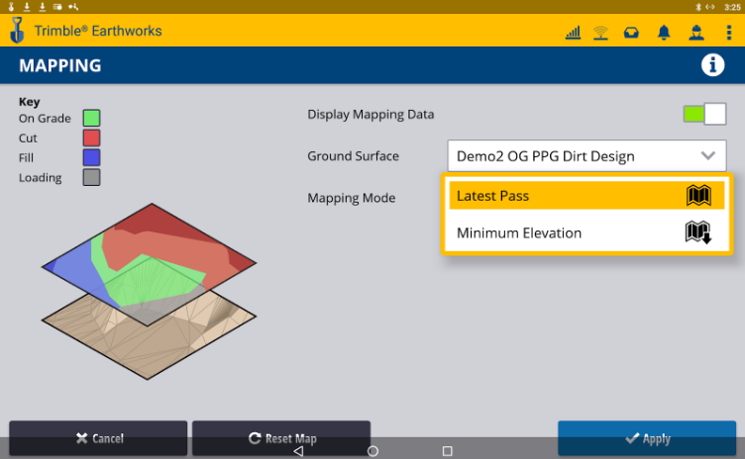
Calculating Volumes for Minimum Elevation Mapping
In conjunction with Trimble Earthworks Release 1.8, Minimum Elevation Mapping is supported in Tag Files going into WorksOS.
For a full explanation on Minimum Elevation Mapping for Trimble Earthworks, please refer to the Trimble Earthworks Version 1.8 Release notes.

Slide 10
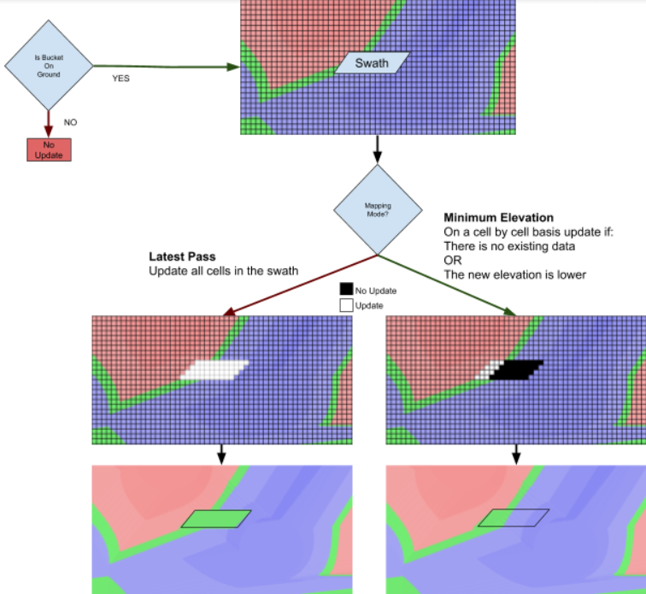
The mapping mode dictates how cells are updated as a swath (from a bucket pass) and rendered into the database. In Latest Pass mode, every cell covered by the swath is updated. In Minimum Elevation mode, a cell is updated if there was no existing value or the new value has a lower elevation. This means Lowest Pass is essentially only recorded for Trimble Earthworks 1.8 TAG Files and to ignore higher passes on the same cell.
Production data (tag files) in 1.8 provide sufficient information for WorksOS to process the mapping mode (minimum elevation vs latest pass) correctly and support for the specific ‘minimum elevation’ tag in VisionLink has been completed.

Slide 11
Note: The logic for calculating Volumes using Minimum Elevation Passes differs from calculating Volumes using Latest Passes due to the nature of a Minimum Elevation looking for the most recent Lowest Pass “as-at” the stated From and and To periods entered in the Volume calculation.
Exceptions include:
Minimum Elevations will look back to the time prior to the “From” period to determine the last known pass, this may be a Surveyed Surface or a cell pass. If it's a cell pass and in min elevation mapping mode it will continue to look back until the lowest pass is found.
The look back through min elevation passes will stop once a Latest Pass found. In that case it will use the lowest pass found up until that point.
If however from the “From” period there is no prior elevation from production, or surveyed surface then the first pass looking forward is used.
Calculating a Volume for Project Extents using Minimum Elevation Pass data will calculate ‘From’ the First (not Lowest) Machine in the Project ‘To’ the Minimum Elevation (Lowest) Pass.
Work Completed (for Project Extents)
Machine First Pass (for Project)
Volume Completed
Initial Machine Lowest Pass (for Project)
Minimum Elevation (Lowest) Pass

Slide 12
If there is a Surveyed Surface present (dated prior to Machine Passes) Calculating a Volume using Minimum Elevation Pass data will calculate ‘From’ the Surveyed Surface ‘To’ the Minimum Elevation (Lowest) Pass.
Work Completed (with a Surveyed Surface)
Original Ground Surveyed Surface
Machine First Pass (for Project)
Volume Completed
Minimum Elevation (Lowest) Pass
Calculating a Volume for set period of time ie Day 6 to Day 9 of Project using Minimum Elevation Pass data will calculate ‘From’ Minimum Elevation (Lowest) Pass Day 6 ‘To’ the Minimum Elevation (Lowest) Pass for Day 9.
Note the ‘From’ Lowest Pass from Day 6 could come prior to it as stated in the rules.
Work Completed (for a period of time)
Minimum Elevation (Lowest) Pass Day 6
Volume Completed
Minimum Elevation (Lowest) Pass Day 9
Calculating a Volume for a single day ie just Day 6 to Day 6 of Project using Minimum Elevation Pass data will calculate ‘From’ the prior Minimum Elevation (Lowest) Pass which is Day 5 in this case ‘To’ the Minimum Elevation (Lowest) Pass for Day 6.
Note this is the look back logic going back to the previous period before Day 6 to determine the ‘From’ Minimum Elevation pass.
Work Completed (for a Daily Volume)
Minimum Elevation (Lowest) Pass Day 5
Machine First Pass (for Day 6)
Volume Completed
Minimum Elevation (Lowest) Pass Day 6

Slide 13
Thank you.

